Slide 1

Sustainability Pioneers:
Community Conversations
#5 Empowering Change

Slide 2
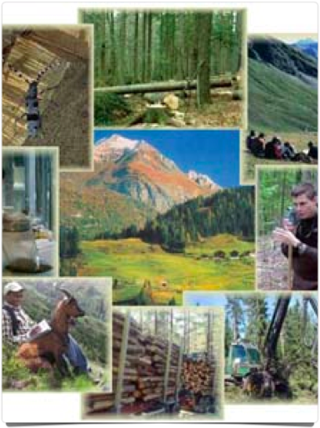

Interconnected Web of Life
“...man does not live apart from the world; he lives in the midst of a complex, dynamic interplay of physical, chemical, and biological forces, and between him and this environment are continuing, never ending interactions.”
Rachel Carson

Slide 3
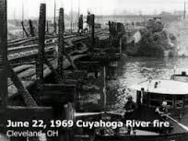
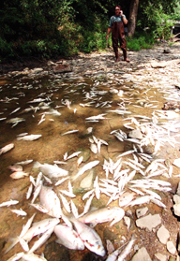
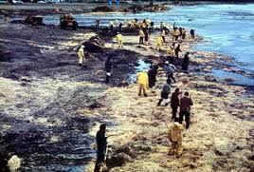
Rise of the Environment Movement
Earth Day
Outrage
Mississippi River fish kill
from DDT plant 1970
Santa Barbara oil spill 1969

Slide 4
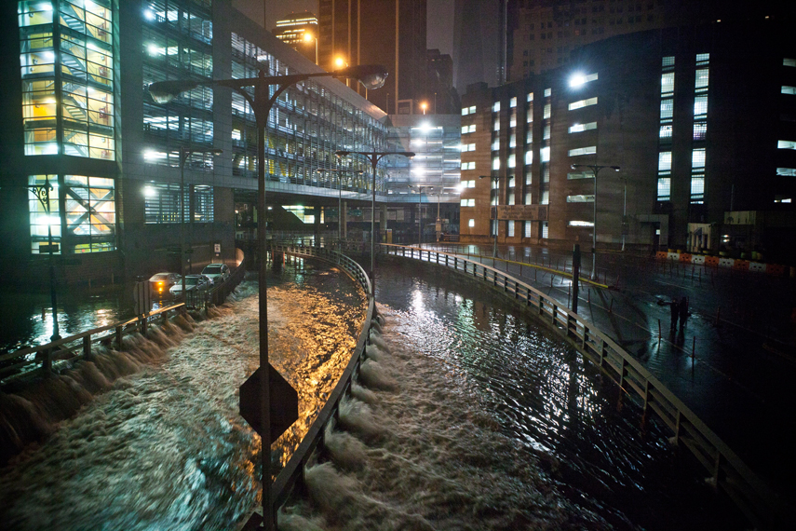
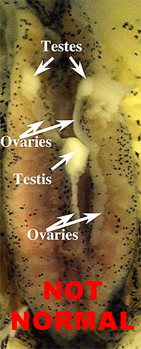
Major threats of our time
Endocrine Disruptors
Climate Change
Tyrone Hayes
Frogs caught
In wild with
both male
and female
parts
New York. Lower Manhattan after
Storm Sandy

Slide 5
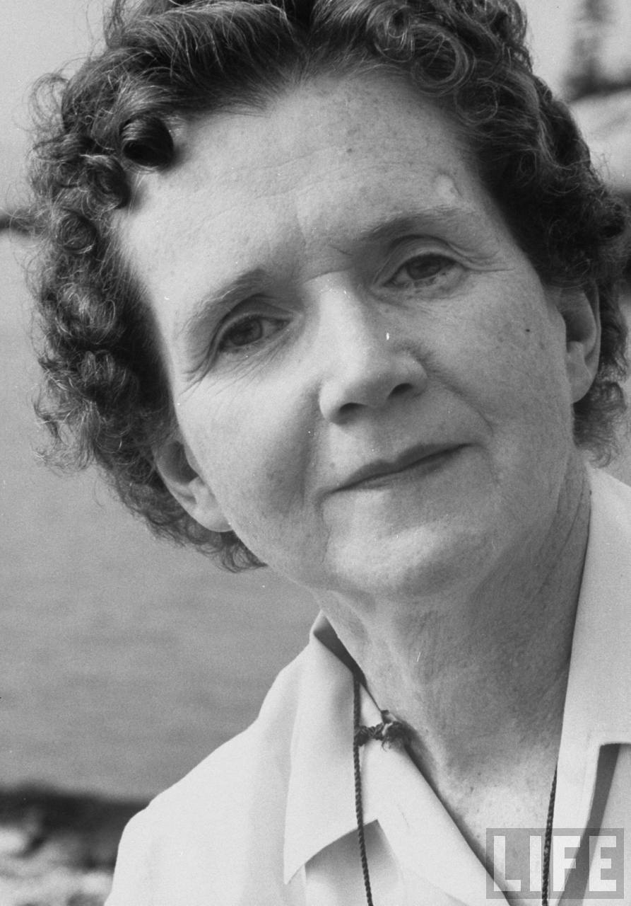
“We should be very clear
about what our cause is.
What do we oppose?
What do we stand for?”
Rachel Carson. Address to Garden Club of America.
January 1963
Notes:
5
Use the knowledge you have gained to challenge
yourself
individuals
businesses
organizations
institutions
government
to make permanent changes in behavior and policies that are in line with Rachel Carson’s ethic.

Slide 6
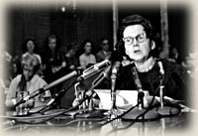
1963 Congressional Hearings
Hearings before the Subcommittee on Reorganization and International Organizations
Coordination of Activities Relating to the Use of Pesticides June 3, 1963

Slide 7
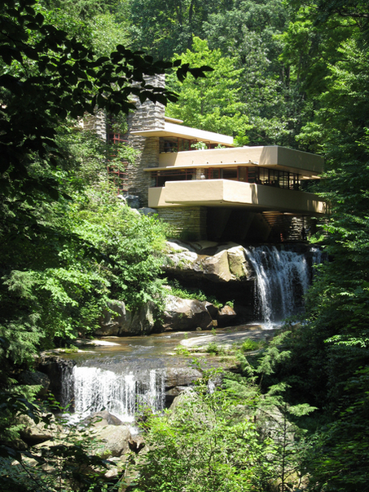
Rachel Carson’s Environmental Ethic
Live in harmony with nature.
Falling Water

Slide 8
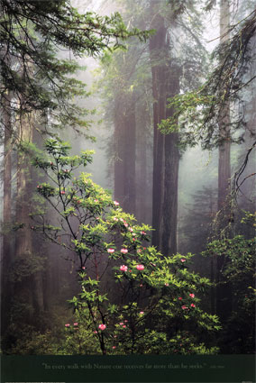
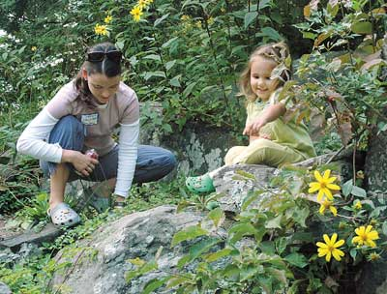
Rachel Carson’s Environmental Ethic
Preserve and learn from natural places.

Slide 9
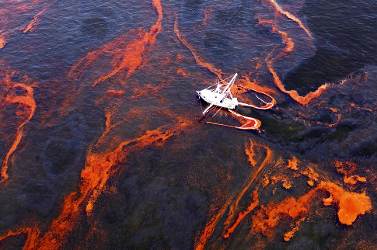
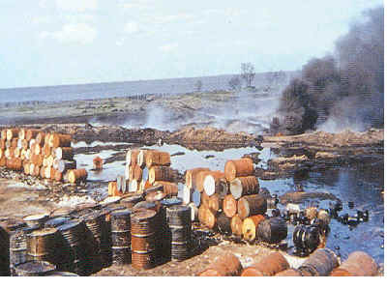
Rachel Carson’s Environmental Ethic
Minimize the impact of man-made chemicals on the natural systems of the world.
BP Deep Water Horizon Oil Spill, March, 2010
Waste chemical dump, coast of Spain

Slide 10

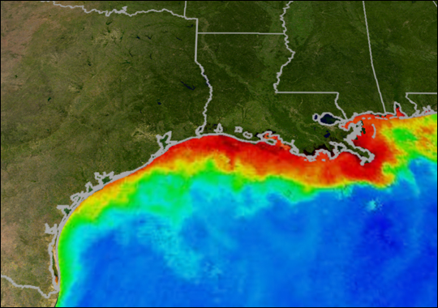
Rachel Carson’s Environmental Ethic
Consider the implications of human actions
on the global web of life.
Fukushima Dai-ichi
NASA photo: Gulf of Mexico August 2009
Notes:
NASA/NOAA
Gulf Dead Zone
The large region of low oxygen water often referred to as the 'Gulf Dead Zone,' shown here, crosses nearly 5,800 square miles of the Gulf of Mexico again in what appears to be an annual event.

Slide 11

Pathways to Our Sustainable Future
Our choices must include the ethical imperative to provide for future generations whose fate we are deciding without their knowledge or consent.

Slide 12
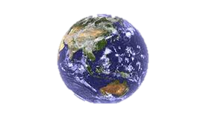
Preserve our Life Support System
Fresh air
Clean water
Fertile ground
Biodiversity of species

Slide 13
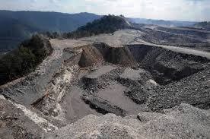
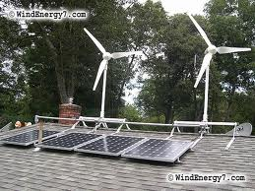
Renewable Energy Systems
From Coal, Oil & Fossil Gas Combustion
To Renewable Resource Systems
Transition

Slide 14
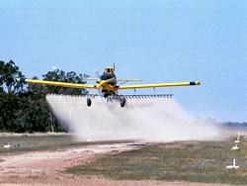
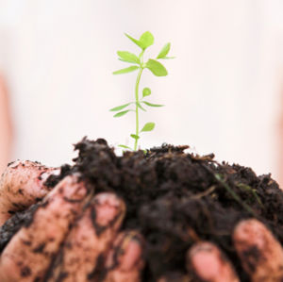
Preserve Fertile Ground
From GMO + Pesticides, Herbicides, Fertilizer
To organic and sustainable agriculture

Slide 15

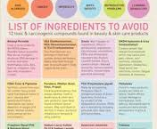
Green Chemistry
Benign by design
Reduce hazard not exposure
See www.ewg.org for info

Slide 16
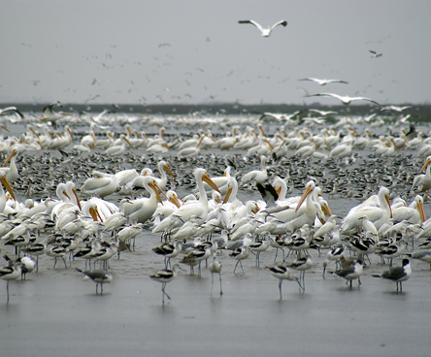
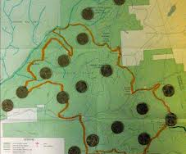
Protect Biodiversity
Wildlife Refuges
Public Parks
Oil Spill in Galvaston Bay
affects bird migration
Hydraulic fracking sites in
PA national forest

Slide 17
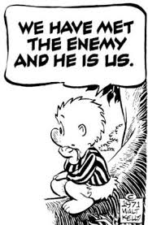
Take Action Yourself!
Choose 100% renewable power
Green Power Network- PA
Buy local and organic foods- demand labeling to avoid GMO
See www.PASA.org
Avoid endocrine disruptors in products you use
See www.ewg.org

Slide 18
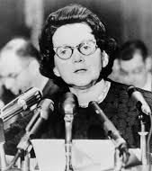
Take Action Yourself!
A chorus of voices!
Demand environmental protection
Stand for justice
Work for social equity
Hold accountable those in power

Slide 19
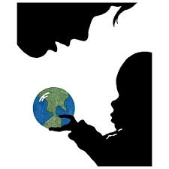
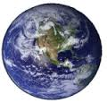
Will we leave
our children
a living Earth?
Or will we be part
of the next
great extinction
of species?

