Slide 1
Perspectives on Nuclear Power
Past and Future
Chernobyl
April 26, 1986
Fukushima Daiichi
March 11,2011
Patricia M. DeMarco, Ph.D.
May 18, 2017

Slide 2
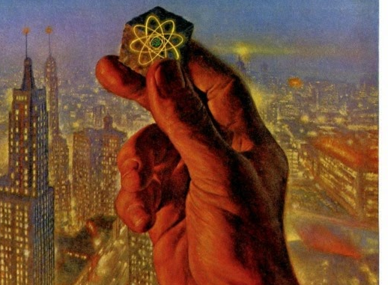
The Promise of Nuclear Power
Expectations for Energy, Health and Safety

Slide 3
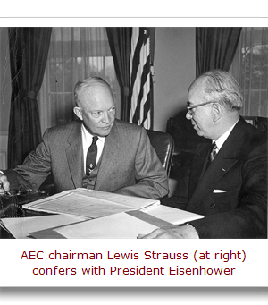
“Atoms for Peace”
Fallout from Nuclear weapons testing in 1950’s and 1960’s
Price Anderson Act 1957- insurance to nuclear industry
OPEC Embargo of 1973 gave a boost to nuclear power, in spite of economics

Slide 4
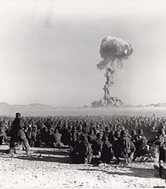
Health Effects from Fallout
1951-1962 Early effects
Leukemia 5 X expected
Thyroid cancer 3 X expected
Lymphoma 2 X expected
1962-1979 – delayed effects:
Leukemia persisted
Breast cancer, melanoma, bone cancer, Gastrointestinal cancer, brain tumors
JAMA. 1984. 251:230-236
Nevada Test Site 1951

Slide 5
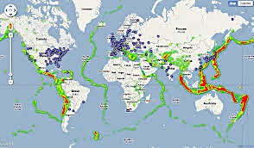
440 Nuclear Power Plants Operating in 2017
Notes:
328 worldwide; 104 in US
11% of global electricity production

Slide 6

Lessons from Two Disasters
Chernobyl and Fukushima

Slide 7
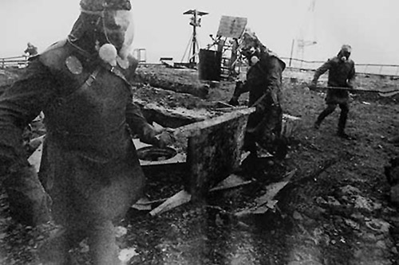
Lessons from Disasters:
Chernobyl April 26, 1986
134 cases of radiation sickness with 30 deaths within 30 days from radiation exposure
Substantial increase in thyroid cancer, especially in children
Double expected levels of leukemia continuing for 20 years
12,000 to 83,000 children born with congenital deformations approx. 207,000 estimated worldwide
Estimated 10,000 to 25,000 excess cancer deaths expected among exposed population
Mental health effects including suicide are most acute and long lasting
http://www.who.int/ionizing_radiation/chernobyl/backgrounder/en/
http://www.ratical.org/radiation/Chernobyl/HEofC25yrsAC.html#ES

Slide 8
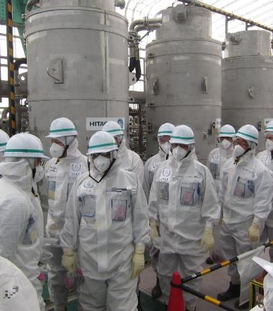
Lessons from Disasters:
Fukushima Daiichi March 11, 2011
11,580 Sq. mi contaminated with Cs-137
159,128 people evacuated from “exclusion Zone”
Scientists call for large scale independent epidemiological studies
Thyroid cancer rates 20 to 50 times national average
Toshihide Tsuda. Okayama University. J. Internat. Soc.Env. Epid.

Slide 9
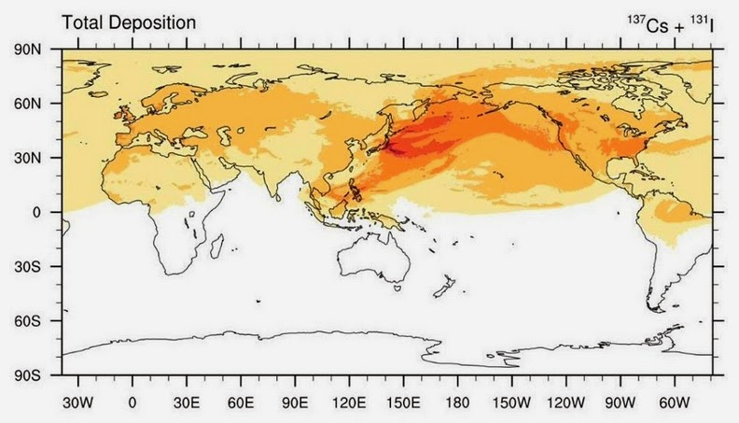
Radiation Plume from Fukushima
Comprehensive Nuclear Test Ban Treaty monitoring at 321 worldwide sensors following Fukushma
Notes:
1,000 Bequerels per square meter fell on US Western seaboard (1Kbq/m2)

Slide 10
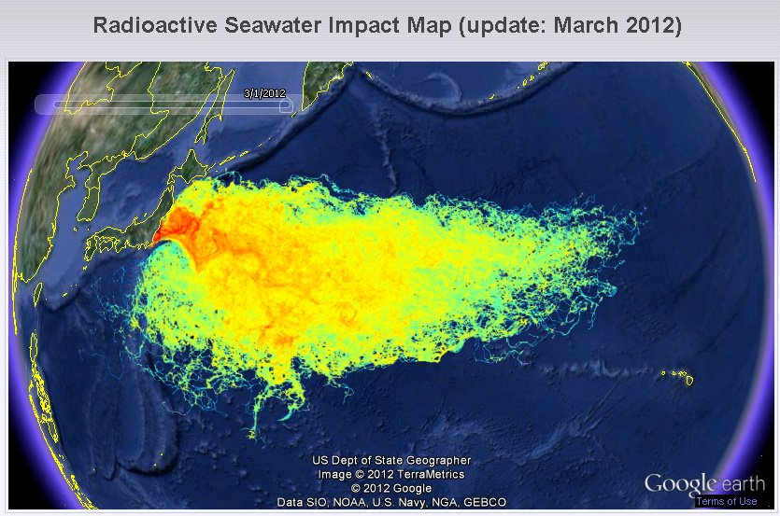

Slide 11
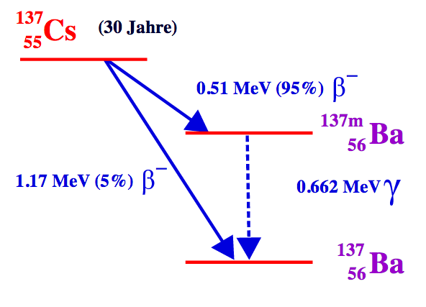
Radioactive isotopes
Cs 137 half life 30 years- highly soluble in water
I-131 half life 8 days- can be blocked by taking iodine tablets
Sr-90 half life of 28 years- incorporated into bones and teeth- acts like Calcium
Plutonium- half life of 24,400 years – from melted reactor core
Volatile- can contaminate wide areas
Biologically active

Slide 12
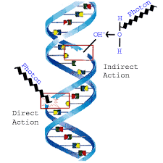
Radioactive isotopes
Acute high dose exposures
Chronic low dose exposures
Somatic disorders
Developmental/genetic disruptions
Effects depend on the exposure mechanism, the dose, and the longevity of exposure

Slide 13
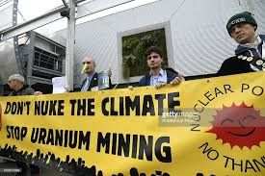
The Way Forward
Nuclear power in our future?

Slide 14
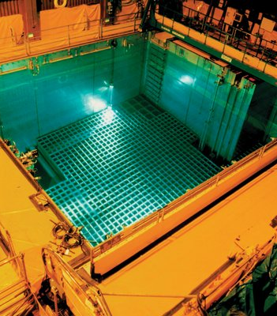
Radioactive Waste
“There are no permanent disposal facilities in the United States for high level nuclear waste (spent fuel)”
NRC
http://www.nrc.gov/reading-rm/doc-collections/nuregs/brochures/br0216/

Slide 15
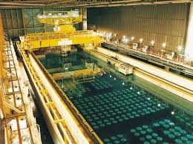
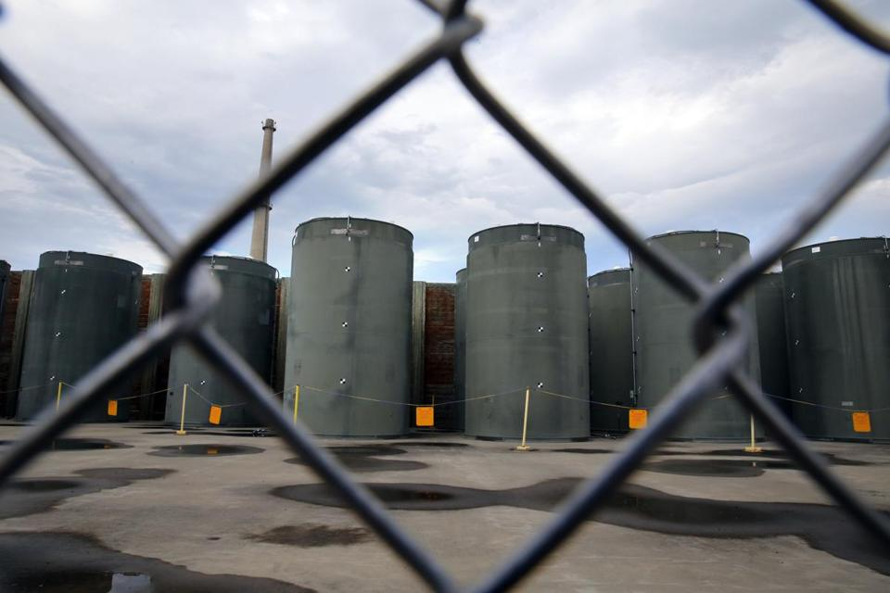
Where is nuclear waste stored now?
Dry cask stroage- Vermont Yankee
Spent fuel pools-
at each nuclear power plant

Slide 16
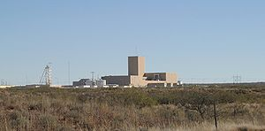
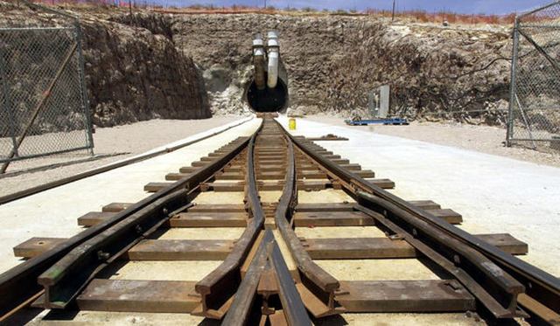
A million year burden
Plutonium has a half-life of 2,000 years
With thousands of tons of spent nuclear fuel accumulating with no definite destination
This is an ethical issue
A burden on future generations
WIPP New Mexico
Yucca Mountain- Nevada

Slide 17

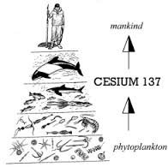
Unintended Consequences
Radiation effects unfold over long periods of time
Radiation accumulates and concentrates in the food chain
Sharp controlled data sets are unavailable, often unobtainable, in aftermath of accidents or tragedies
Environmental effects accumulate over generations

Slide 18
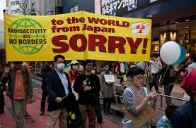
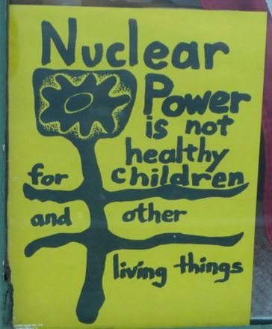
Many Voices – New Ideas
COP21 December 2015
Seabrook Protest 1973

Slide 19
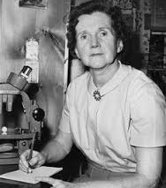
Precautionary Principle
“Underlying all of the problems of introducing contamination into our world is the question of moral responsibility – not only to our own generation but to those of the future.”
Rachel Carson
1963 “The Pollution of Our Environment” in Lost Woods. P. 242

Slide 20

There is No “Planet B” …
Patricia M. DeMarco, Ph.D.
www.patriciademarco.com
The Power of One Voice film
Sustainability Pioneers
“Pathways to Our Sustainable Future” University of Pittsburgh Press 2017.

Slide 21
Radiation Units of Dose
Units Symbol Conversion Factors
Becquerel (SI) Bq 1 disintegration/s = 2.7 × 10−11 Ci
Curie Ci 3.7 × 1010 disintegrations/s = 3.7 × 1010 Bq
Gray (SI) Gy 1 J/kg = 100 rads
Rad rad 0.01 Gy = 100 erg/g
Sievert (SI) Sv 1 J/kg = 100 rem
Rem rem 0.01 Sv
NOTE: Equivalent dose equals absorbed dose times Q (quality factor). Gray is the special name of the unit (J/kg) to be used with absorbed dose; sievert is the special name of the unit (J/kg) to be used with equivalent dose.
BIER VII Phase 2 Report of the National Academies National Academies Press.
http://www.nap.edu/

